Slide 1
Analyse The Reasons Behind Common Negative Attitudes Towards Artificial Intelligence
Amy Rafferty

Slide 2
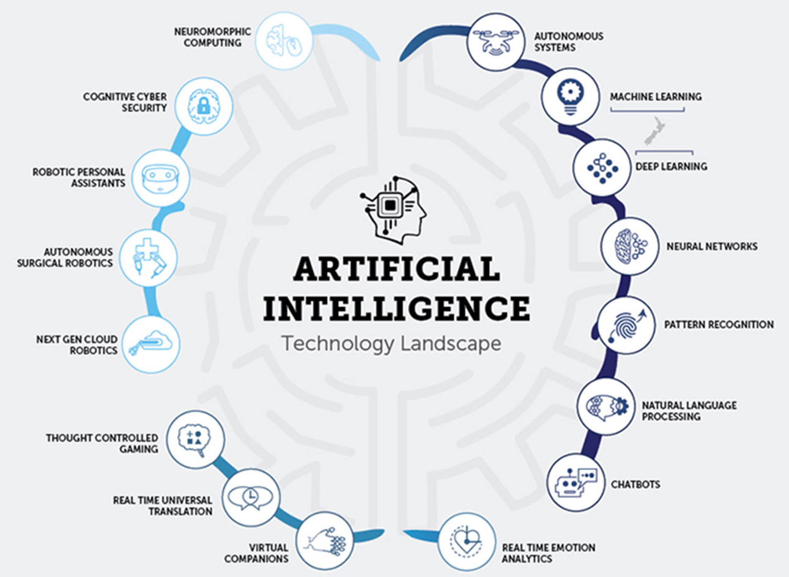
COMING UP WITH THE THEME.

Slide 3
GETTING TO THE TITLE.
Initial Title: To what extent could Artificial Intelligence replace the human race?
Refined Title: To what extent could Artificial Intelligence replace humanity in the workplace?
New Title: Analyse and evaluate common reasons behind positive and negative attitudes to Artificial Intelligence.
Final Project Title: Analyse the reasons behind common negative attitudes towards Artificial Intelligence.

Slide 4
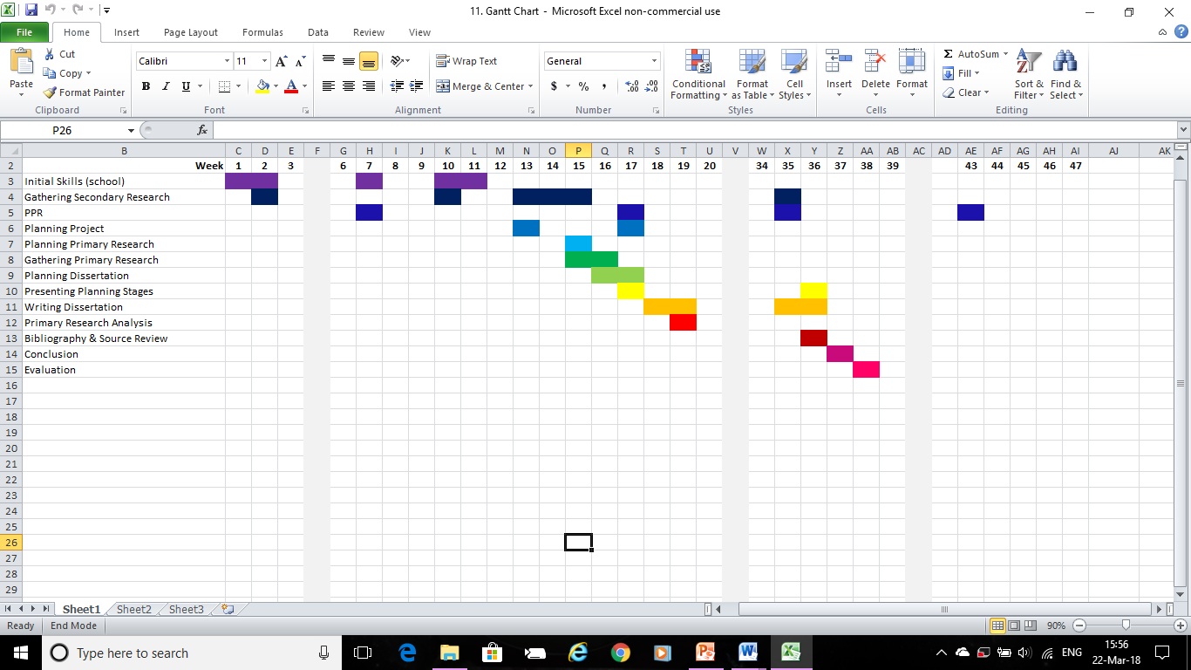
DOCUMENTING THE PROCESS.
I documented everything I did during my project on a Gantt Chart, as well as on a Detailed Progress Plan, making sure I included everything on the checklist that I was given to me.
This helped me to keep track of what I was doing and make sure I had enough time to dedicate to each part.

Slide 5

TIME MANAGEMENT.
The Main Issues:
Getting replies from primary research questionnaire
Typing up dissertation and planning stages to a decent standard
Prioritising A Levels while still dedicating time to the project
Successes:
Did secondary research and most planning over summer before Year 13, so had significantly less to do during school time
Secondary research was very easy and took very little time

Slide 6
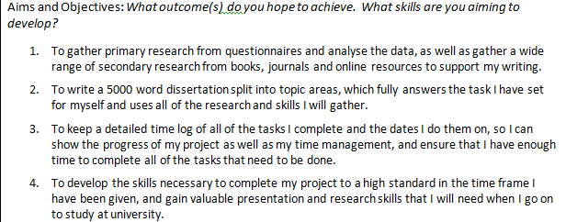
AIMS AND OBJECTIVES.
I think I managed to fulfil all of the aims and objectives I had set out for this project. I also fulfilled my rationale, which was to understand the reasons behind negative attitudes towards AI in order to have a more two-sided scope of the technology, which will help me in future study and careers.

Slide 7
PROBLEMS ENCOUNTERED.
The main problem I encountered was coming up with a relevant conclusion to sum up my project, as my project title didn’t exactly set me up to answer a specific question.
Another problem was condensing everything down into a decent word count, and even after that the total came to about 10,000 words.
Final Project Title: Analyse the reasons behind common negative attitudes towards Artificial Intelligence.
If I could redo the project, I would slightly alter my title to become:
What are the most prominent reasons behind negative attitudes towards AI?
If I had done this, I would have actually had something to answer in my conclusion. As it was, I ended up answering this question anyway.

Slide 8
THE ANSWER.
So what actually are the main reasons behind negative attitudes towards AI?
Lack of knowledge on the subject, fear of what you don’t understand
The technology is showing to be more beneficial to the rich, and less so for the rest
Fear of losing control of the technology and any unforeseen side effects

Slide 9
WHAT I WOULD CHANGE.
Alter title to ask an actual question for a better conclusion
Get more data for my primary research – ask people in the industry, ask more questions regarding negative opinions specifically, allow more time for receiving responses
Spread project out more evenly instead of doing in bursts with long gaps in between
Find a way to cut down the length of the final piece, maybe by making the title even more specific

Slide 10

SKILLS AND EXPERIENCE GAINED.
I am planning to go on to study Artificial Intelligence at University, and this project has given me some valuable background knowledge on the subject which will be very useful to me.
I have also figured out how I like to do projects, what works for me, and what I need to spend more time working on. This will also prove very useful in the future.

